Slide 1
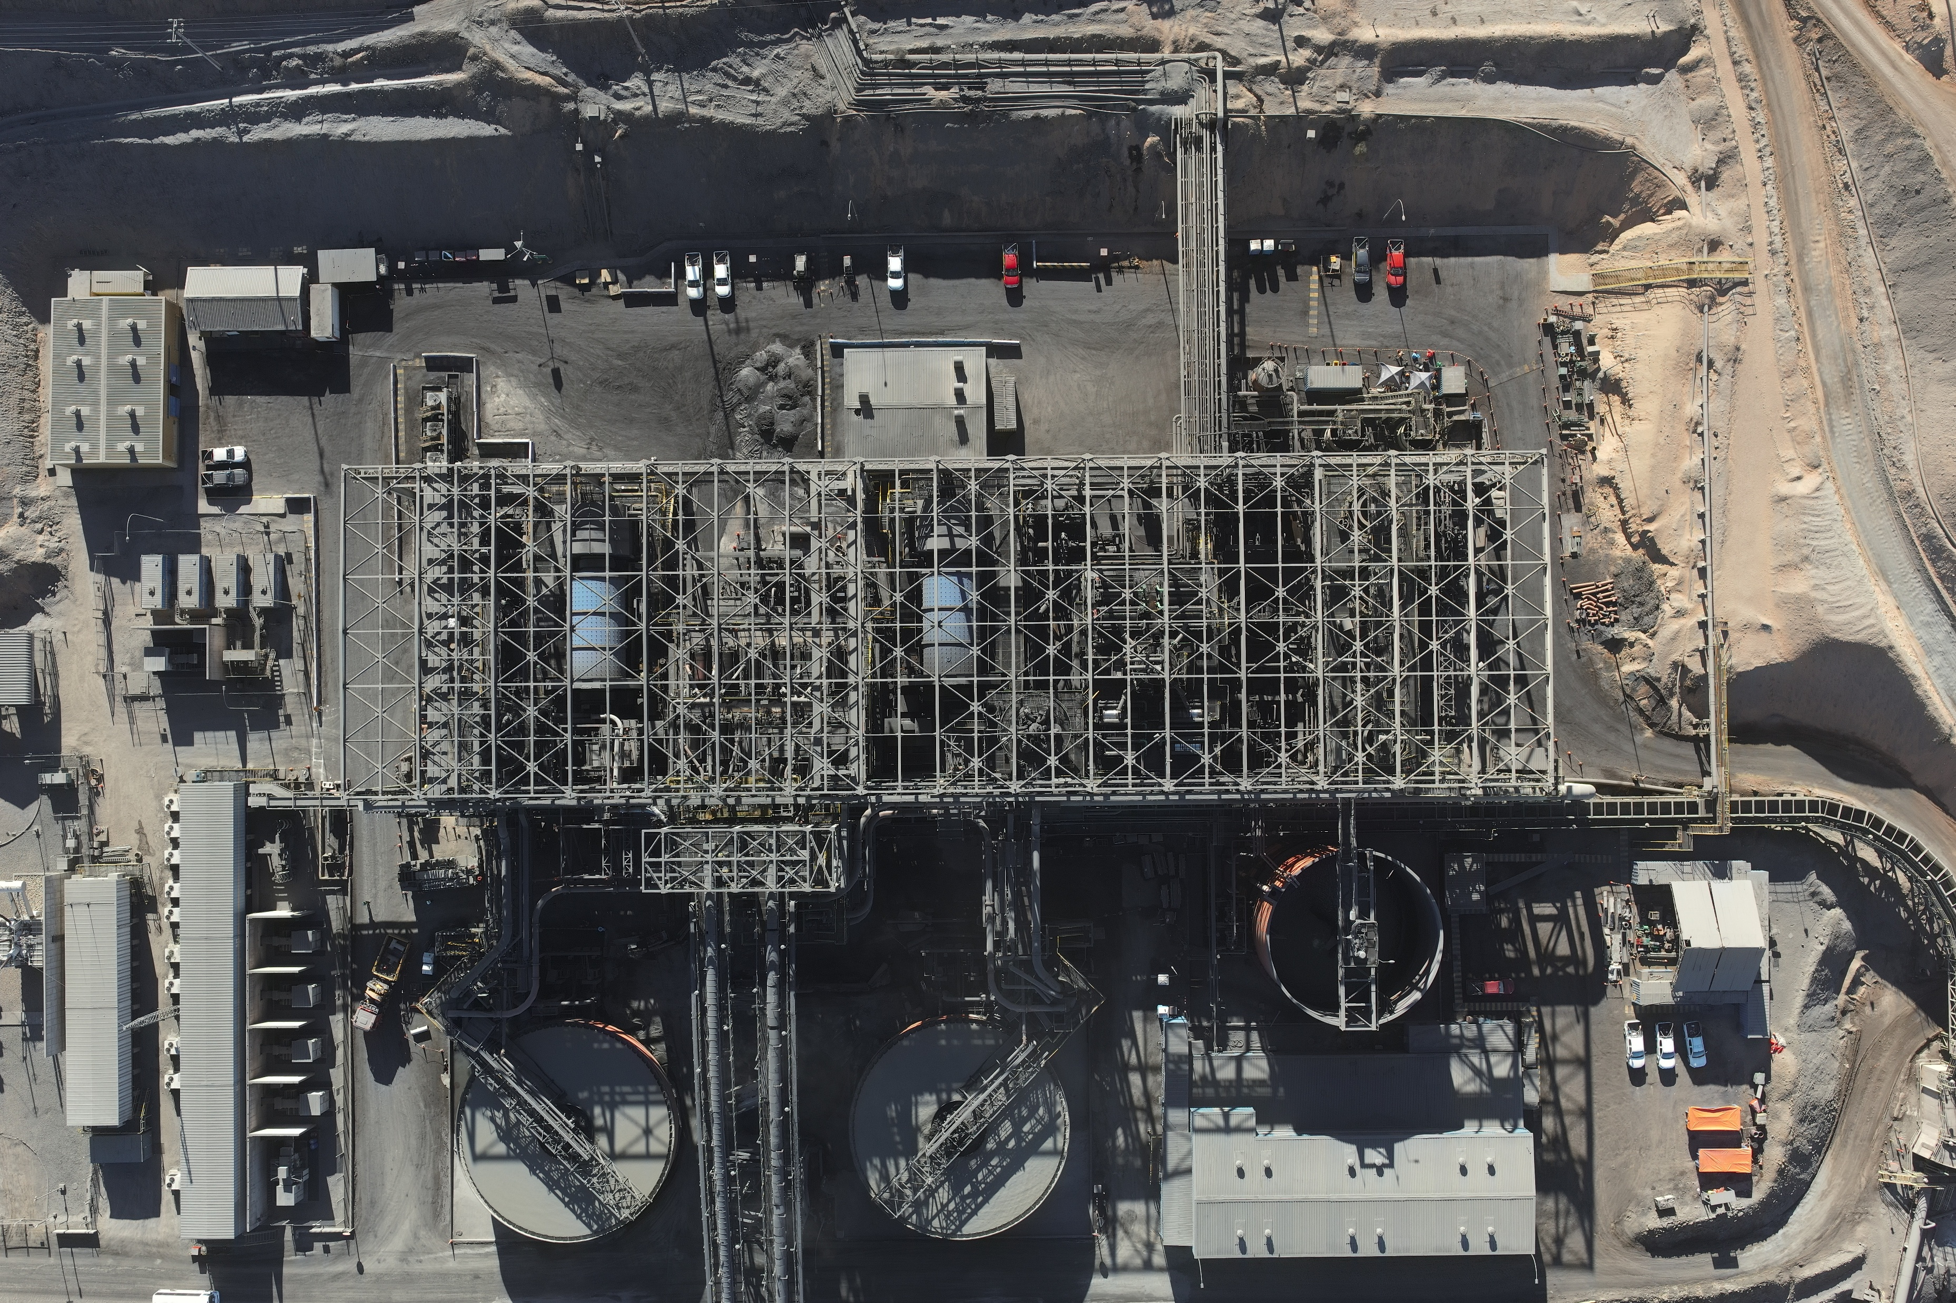

Operación
MSS - CNN
Reporte diario
25 Febrero 2026

Slide 2
Resumen Resultados
25 Febrero 2026
01/marzo/26 | 01/marzo/26
 | T1 |  |  | T2 |  |  | Total Día
 | Real | Plan | Cump. [%] | Real | Plan | Cump. [%] | Real | Plan | Cump. [%]
Alimentación M1° [t] | 8962 | 9987.8 | 90% | 8705 | 9987.8 | 87% | 17667 | 19975.5 | 88%
FeT [%] | 43.6 | 39.4 | 111% | 35.5 | 39.4 | 90% | 39.6 | 39.4 | 101%
FeMag [%] | 42.6 | 38.0 | 112% | 34.3 | 38.0 | 90% | 38.5 | 38.0 | 101%
FeDtt [%] | 69.8 | 68.1 | 102% | 68.4 | 68.1 | 100% | 69.1 | 68.1 | 101%
%SiO2 | 20.2 | - | - | 0 | - | - | 10.2 | - | -
Producción Total [t] | 5264.4 | 5408.2 | 97% | 4422.6 | 5408.2 | 82% | 9687.0 | 10816.5 | 90%
FeT [%] | 66.2 | 65.5 | 101% | 66.1 | 65.5 | 101% | 66.1 | 65.5 | 101%
%SiO2 | 4.4 | 5.5 | 80% | 0 | 5.5 | 0% | 2.4 | 5.5 | 44%
Rp [%] | 53.7 | 49.5 | 108% | 46.5 | 49.5 | 94% | 50.2 | 49.5 | 101%
Rm [%] | 74.5 | 82.3 | 91% | 79.2 | 82.3 | 96% | 83.7 | 82.3 | 102%
Rmm [%] | 75.8 | - | - | - | - | - | 85.5 | - | -
REF [tph] | - | - | - | - | - | - | 736.1 | 890 | 83%
02/marzo/26 | 02/marzo/26
 | T1
 | Real | Plan | Cump. [%]
Alimentación M1° [t] | 8415 | 9987.8 | 84%
FeT [%] | 38.8 | 39.5 | 98%
FeMag [%] | 37.6 | 38.1 | 99%
FeDtt [%] | 68.5 | 68.1 | 101%
%SiO2 | 0 | - | -
Producción Total [t] | 4204.5 | 5412.4 | 78%
FeT [%] | 65.2 | 65.5 | 100%
%SiO2 | 0 | 5.5 | 0%
Rp [%] | 45.7 | 49.6 | 92%

Slide 3
Compromisos
Compromisos | Responsable
Cambio de parámetros CN07 y CN08 | Jorge Carrasco
Verificación flujómetro y densímetro MM02 | Eric Gajardo/ Gilbert Torres
Pruebas de Cp (MX001/MX002) | Álvaro Alcayaga/Nicolás Aguilar
Plan de mantenimiento (by Pass) | Cristián Valdes

Slide 4
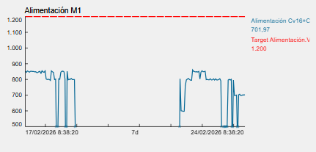
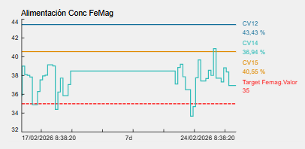
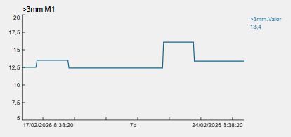
Sistema 1: Alimentación

Slide 5
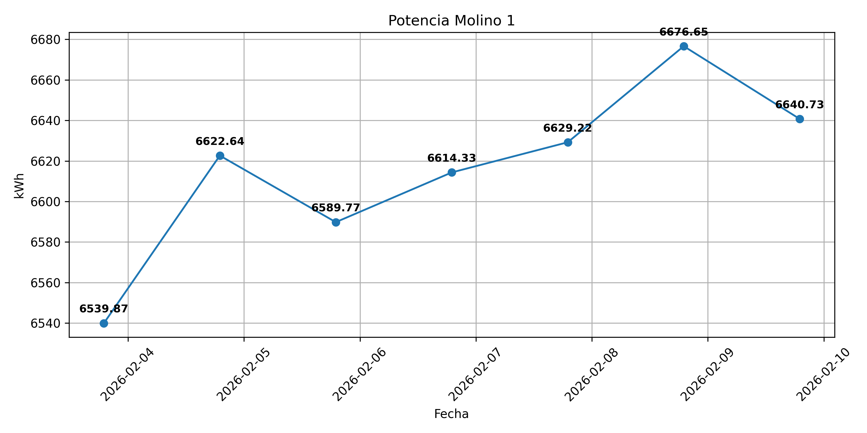
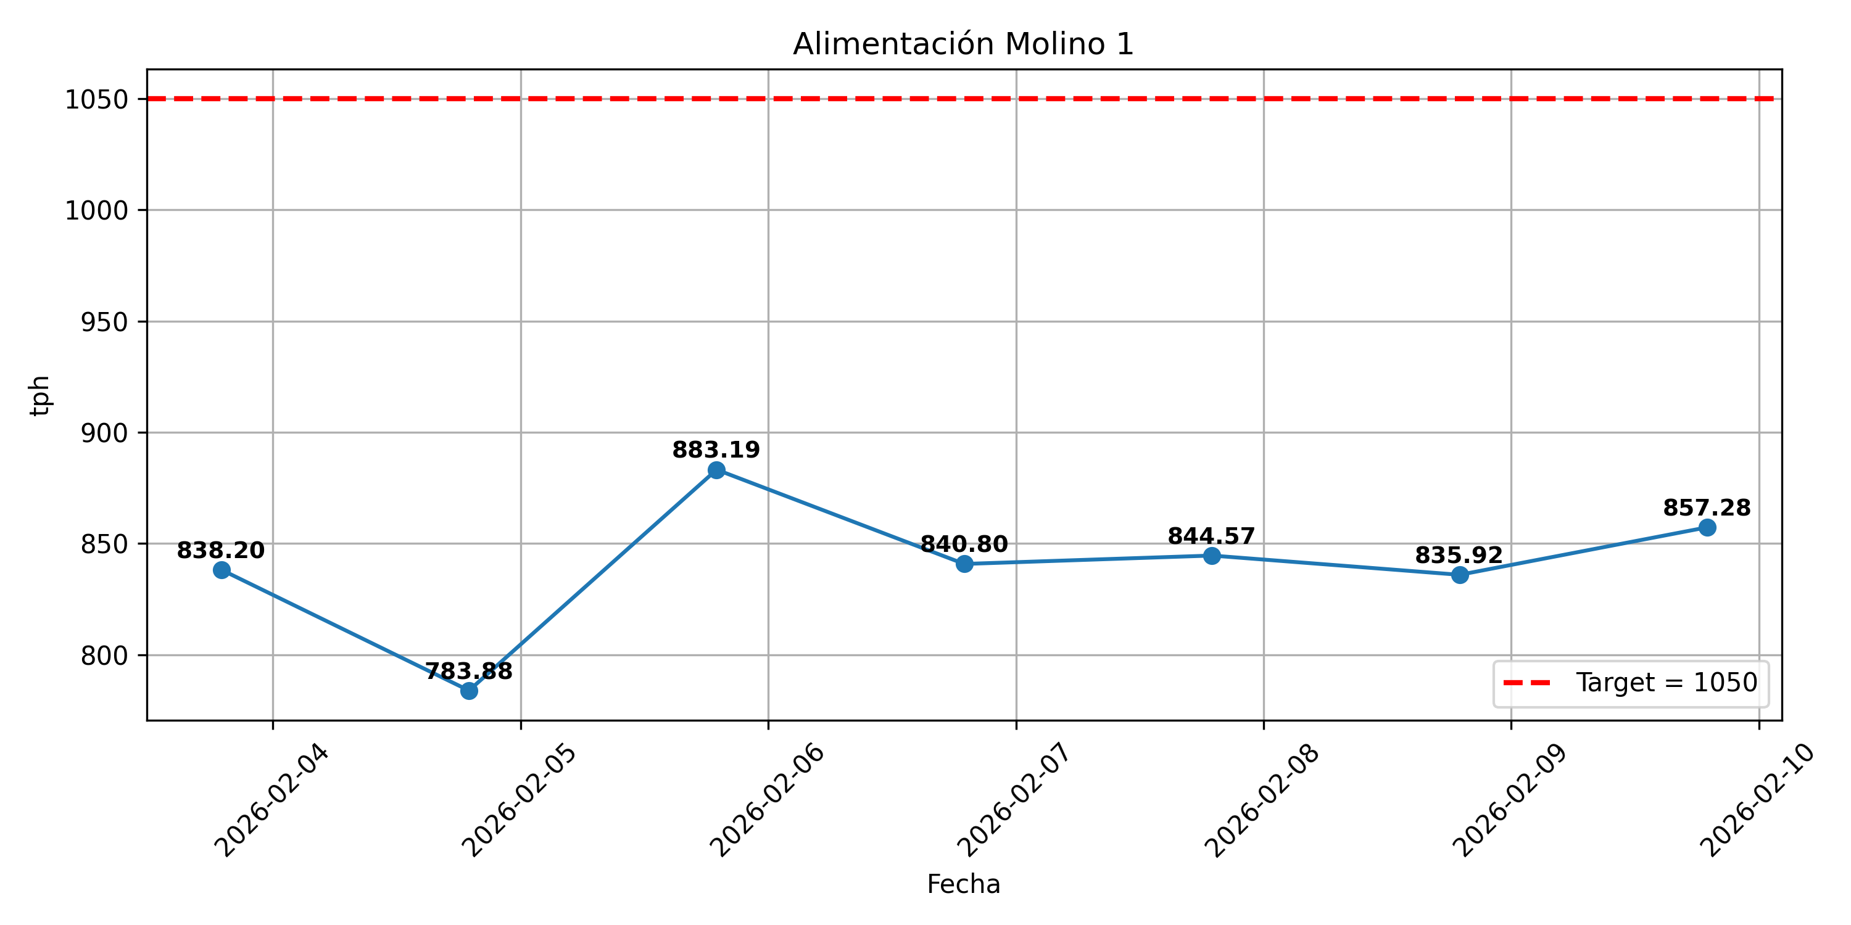
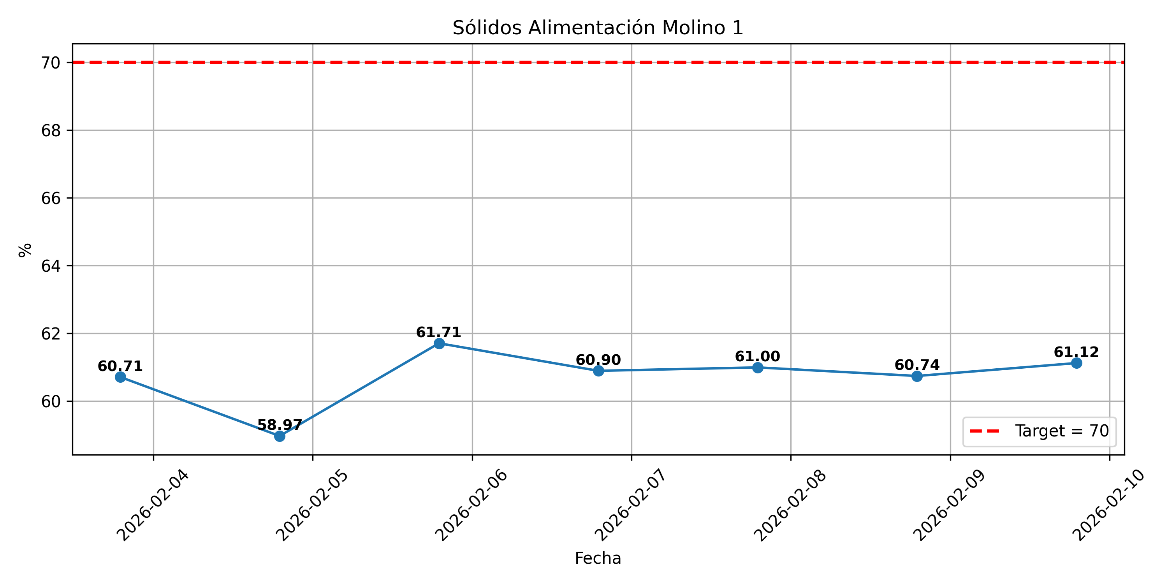
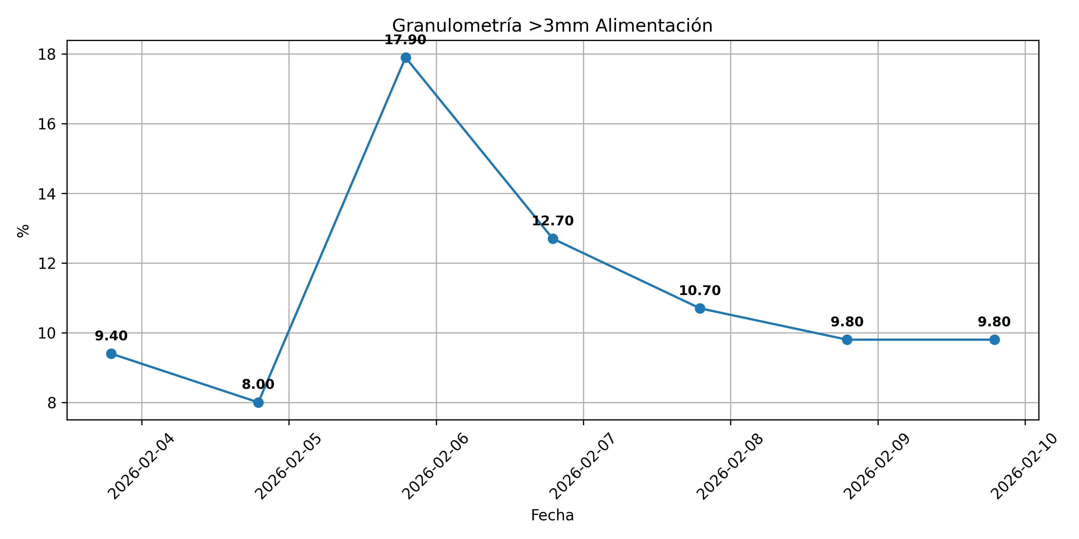
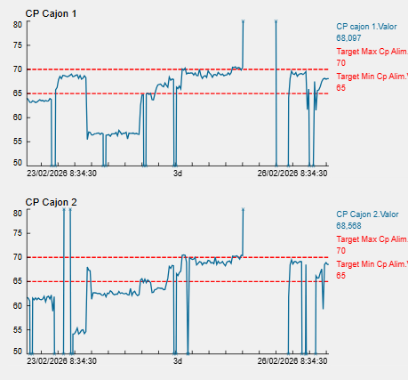
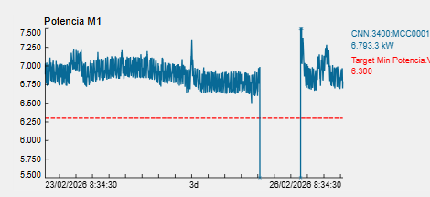
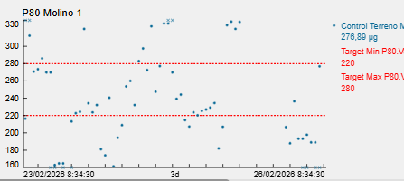
Sistema 2: Molino 1

Slide 6
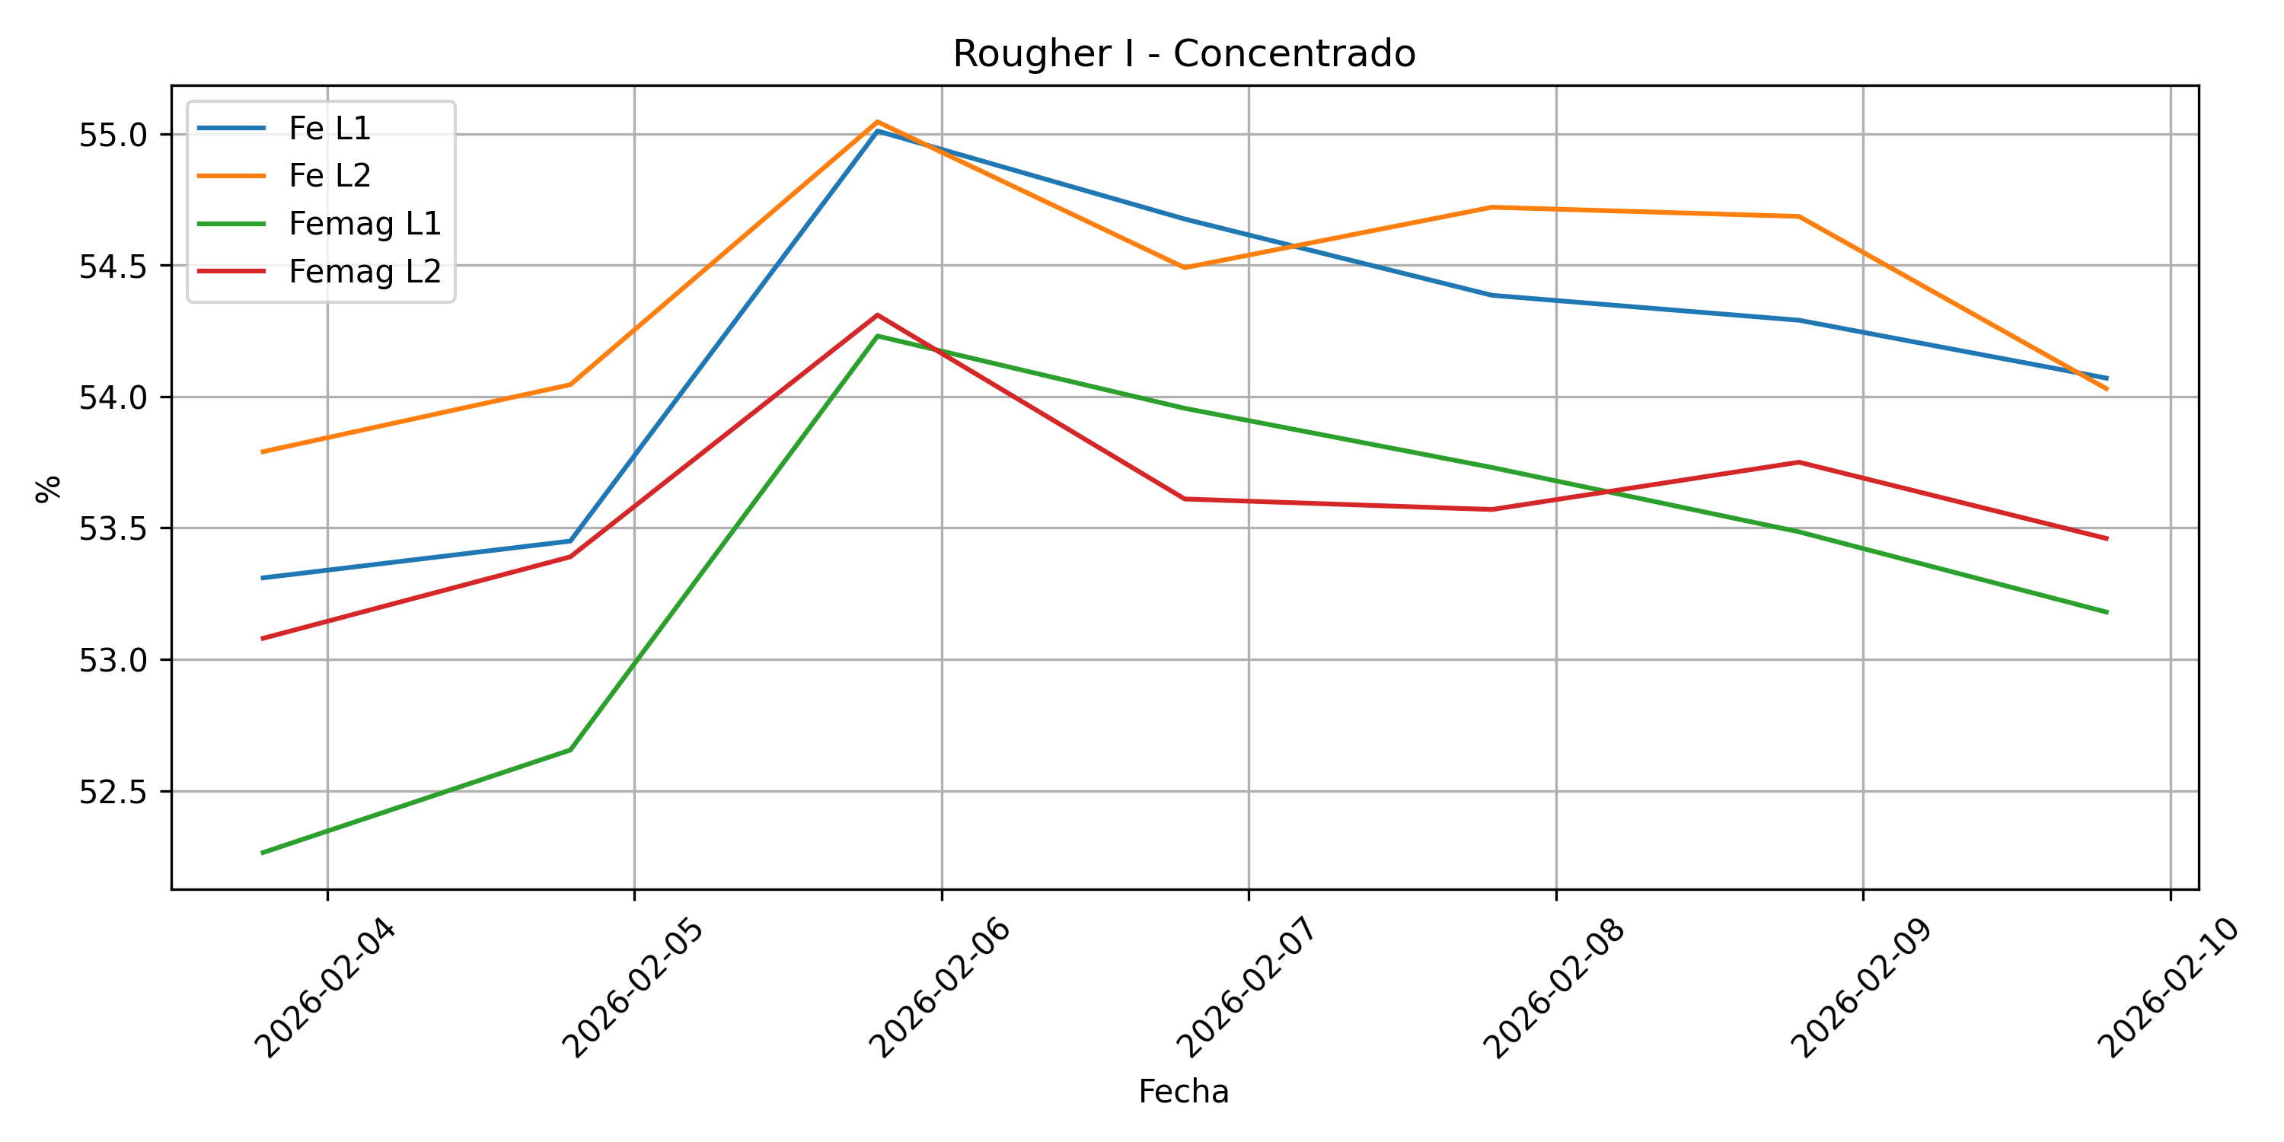
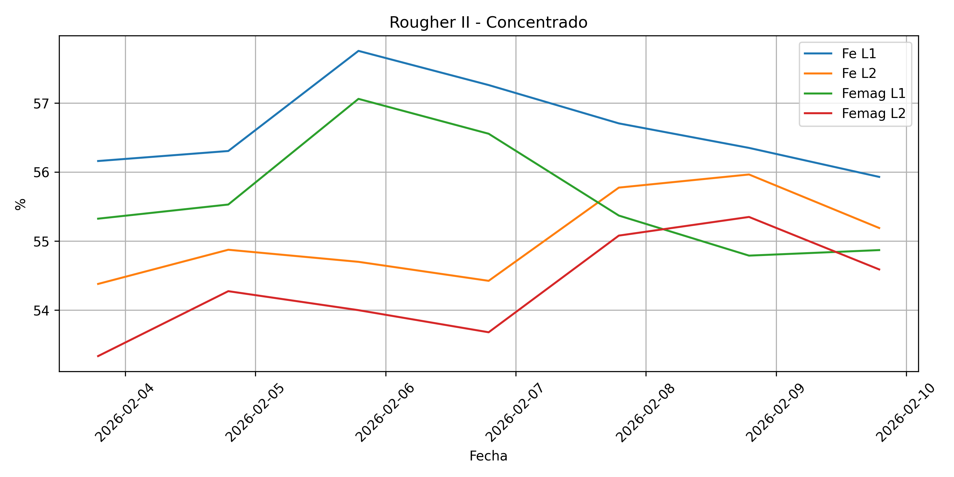
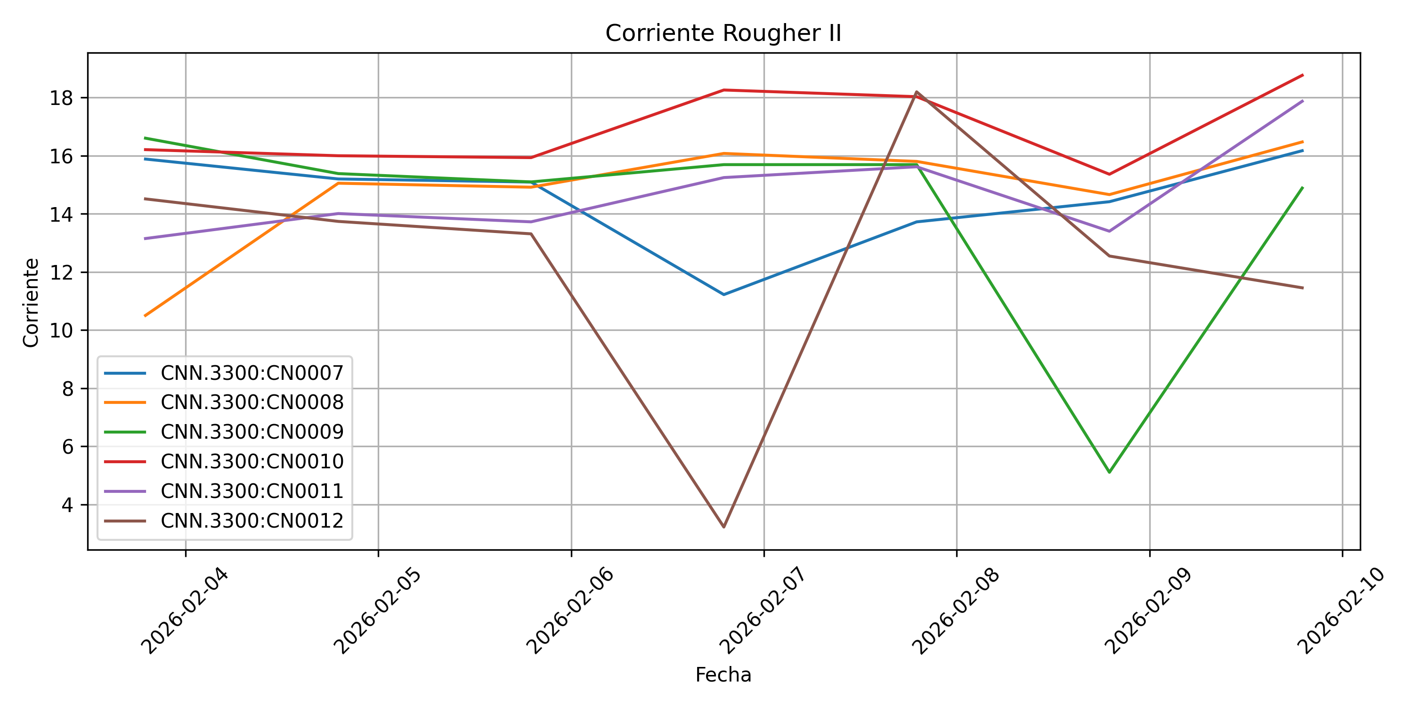
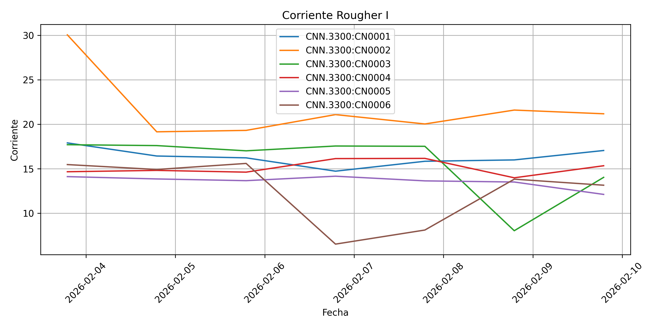
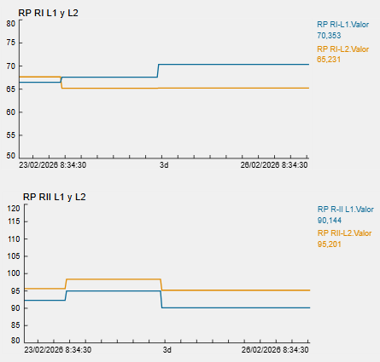
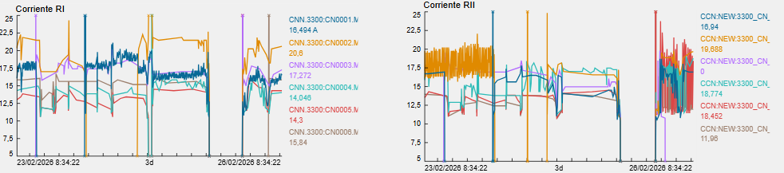
Sistema 3: Rougher I y II

Slide 7
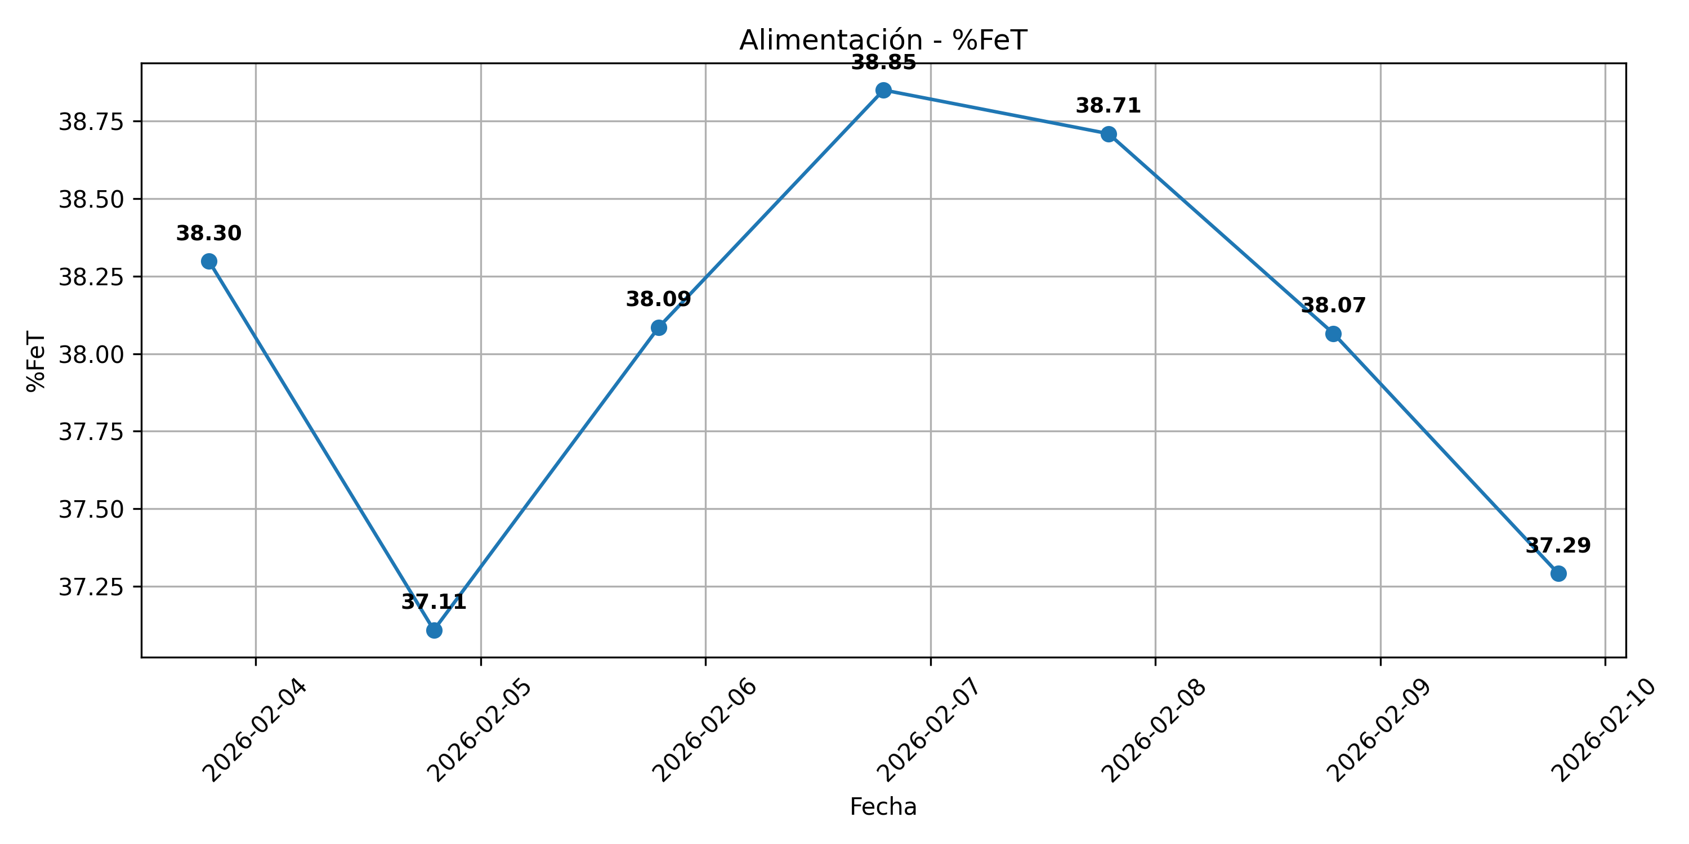
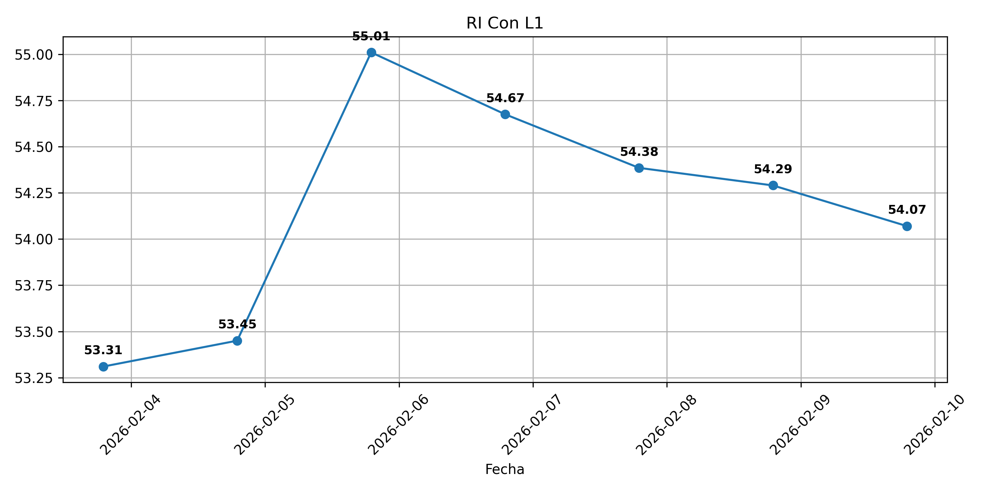
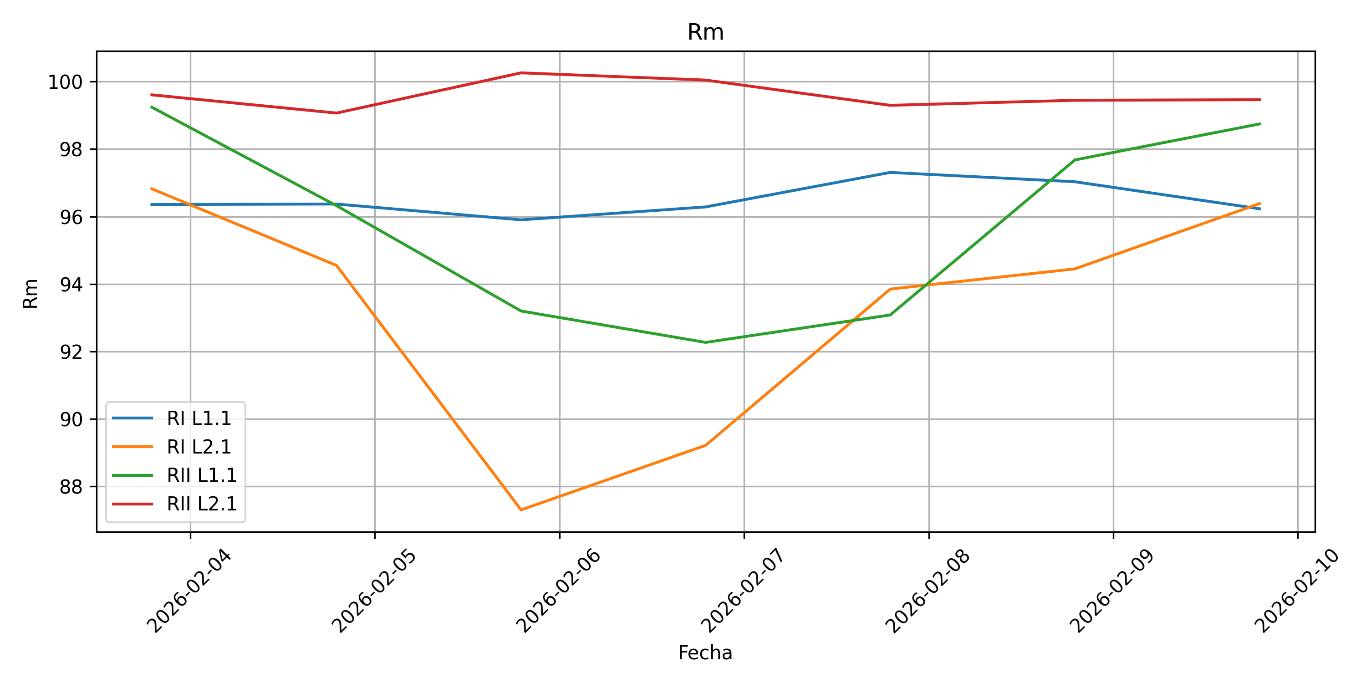
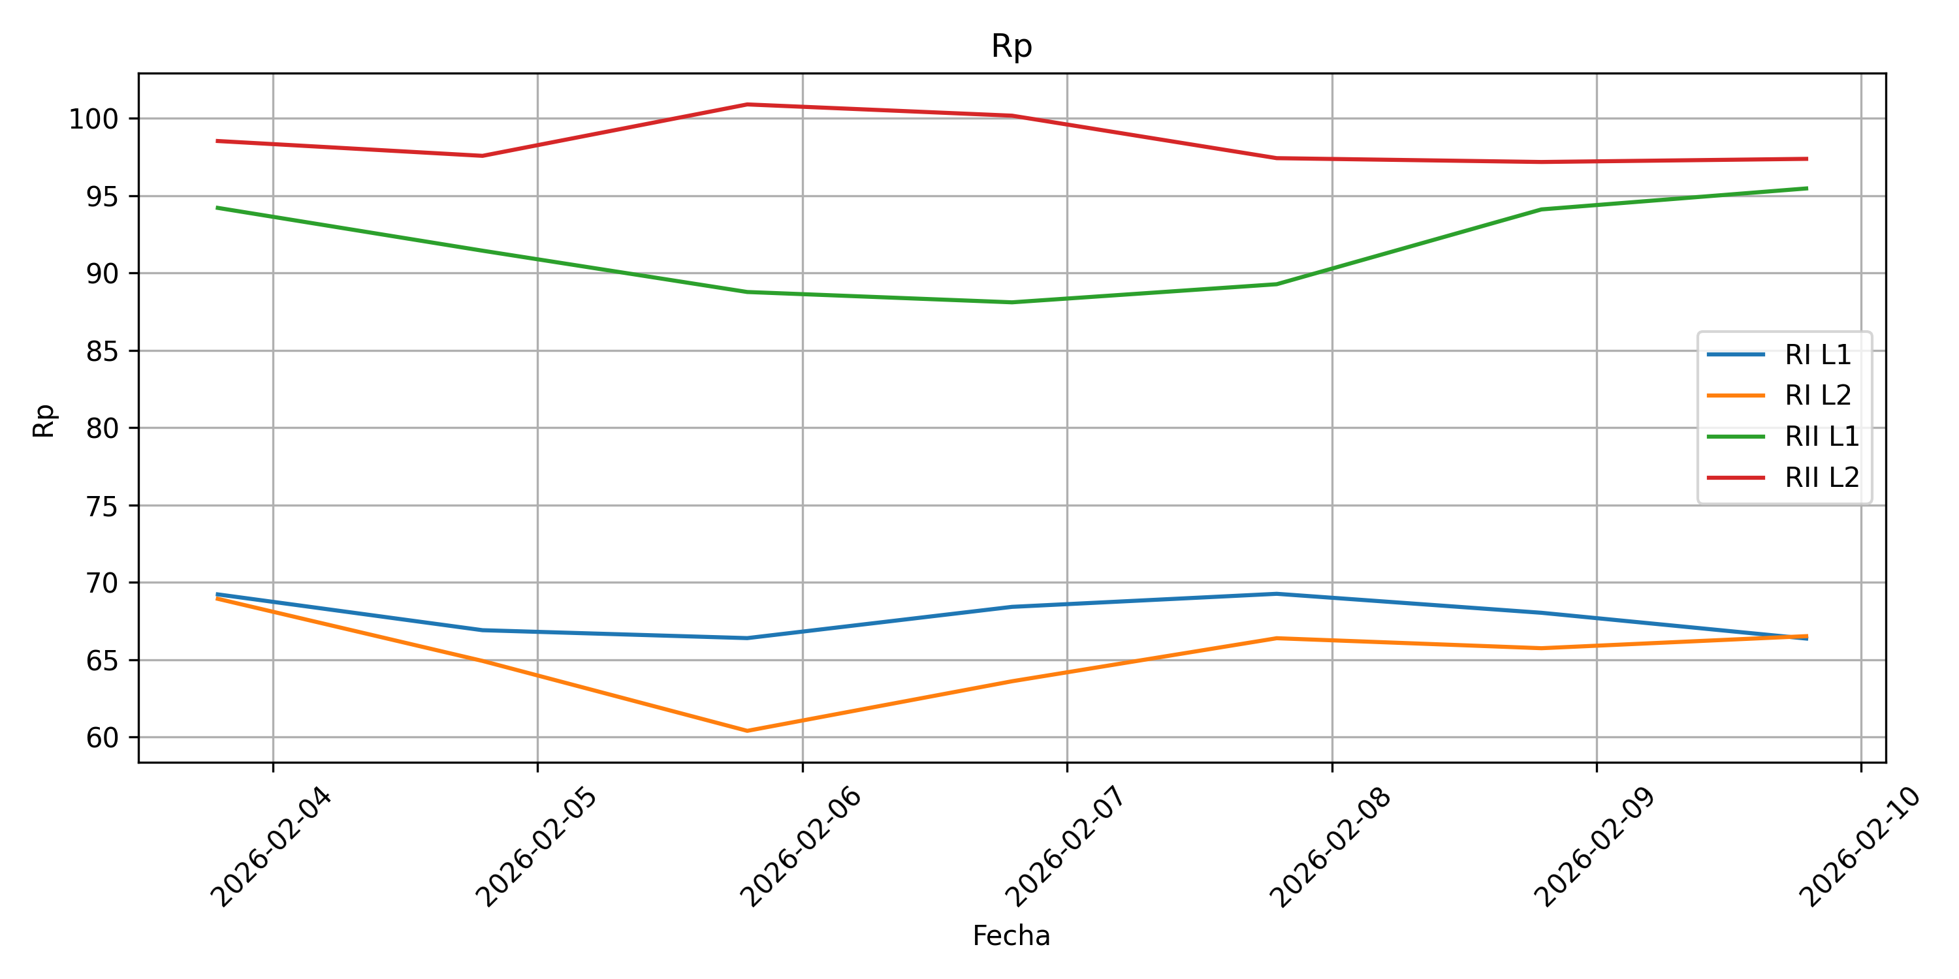
Sistema 3: Rougher I y II

Slide 8
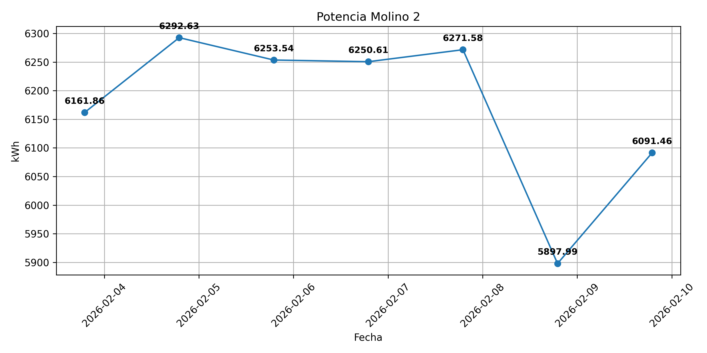
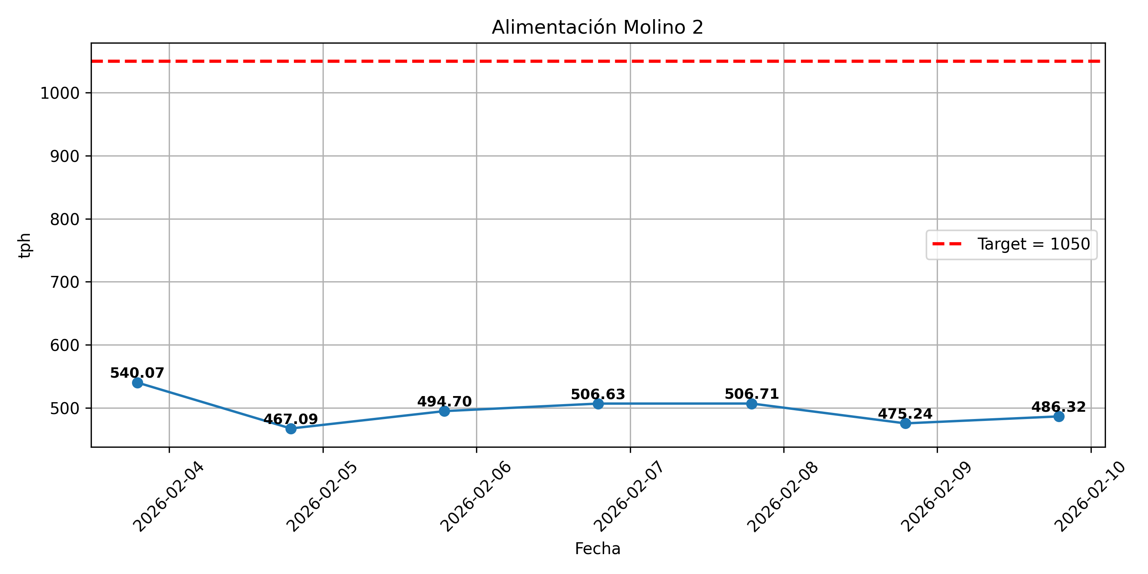
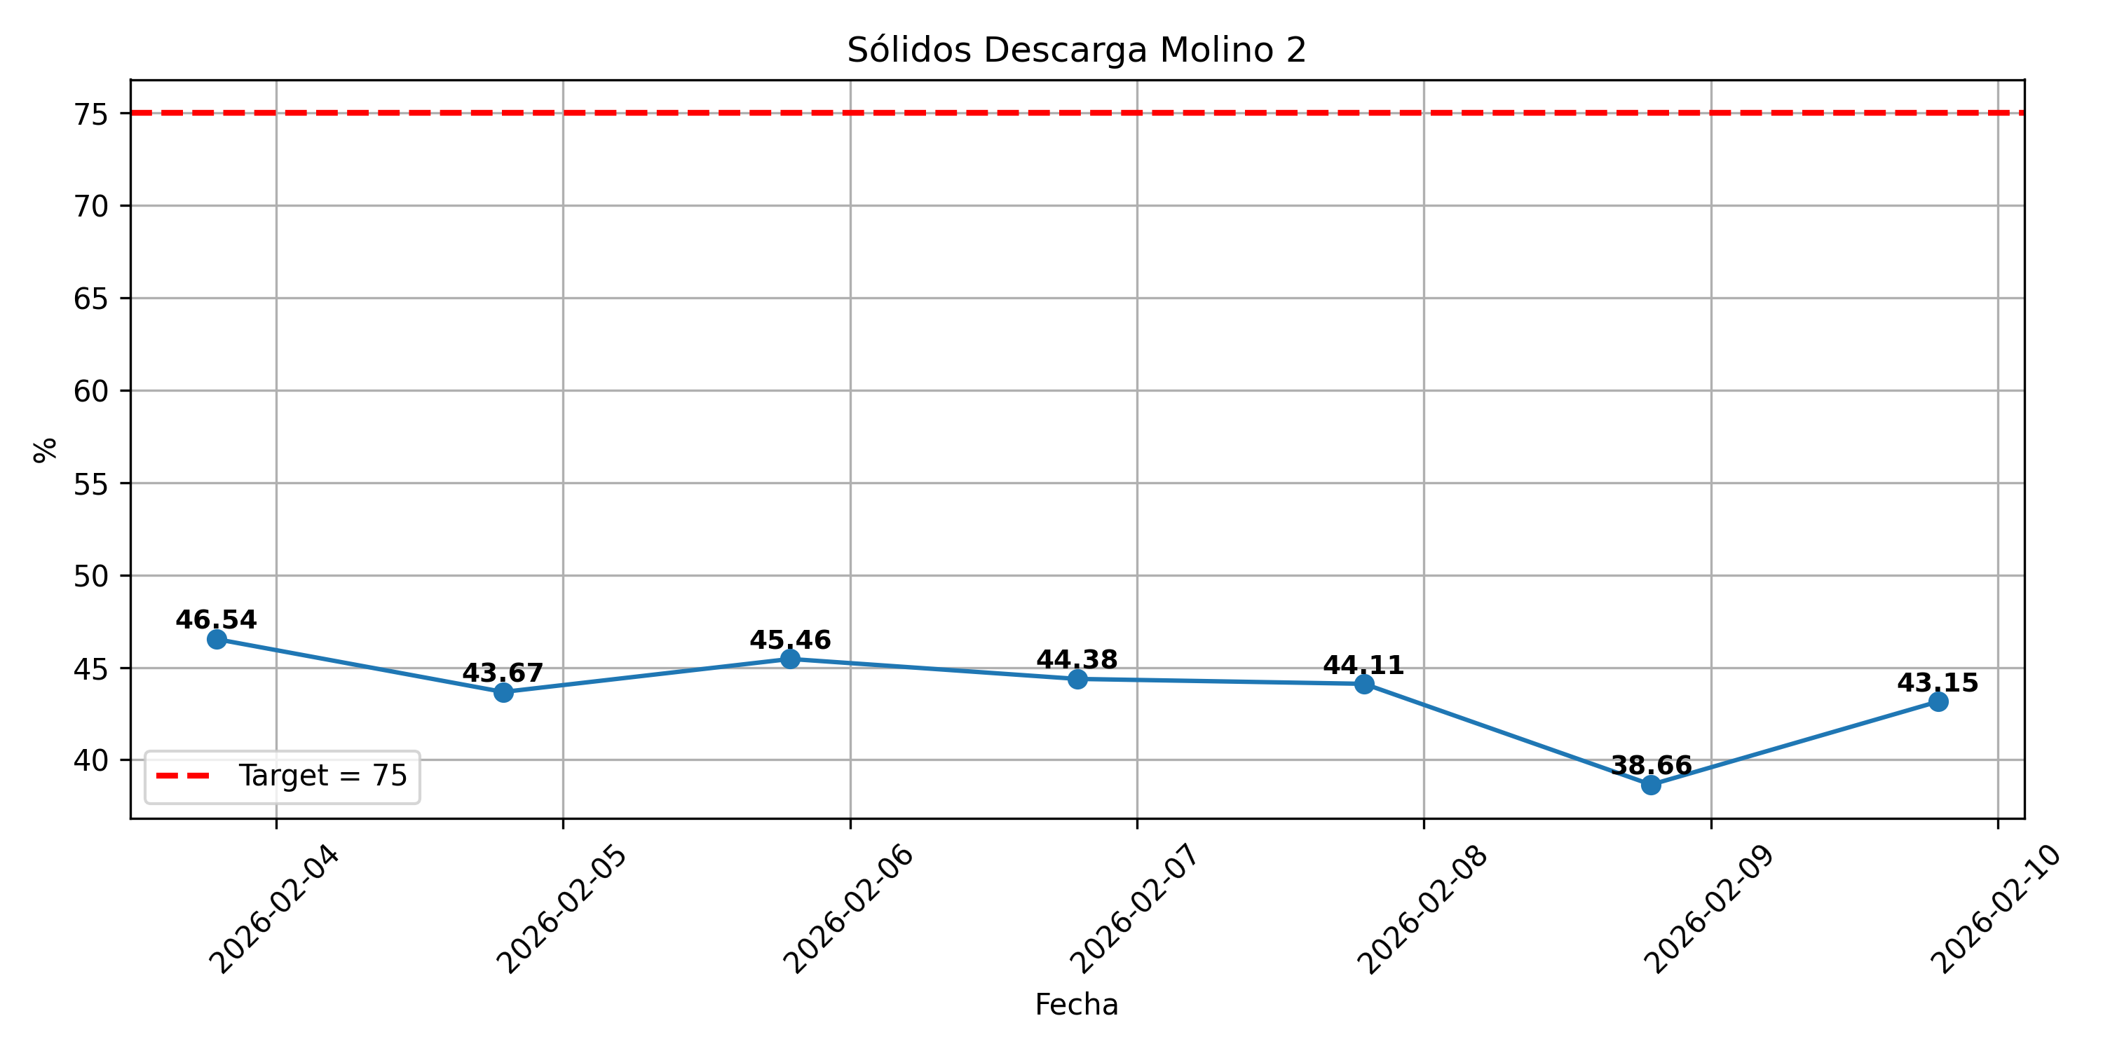
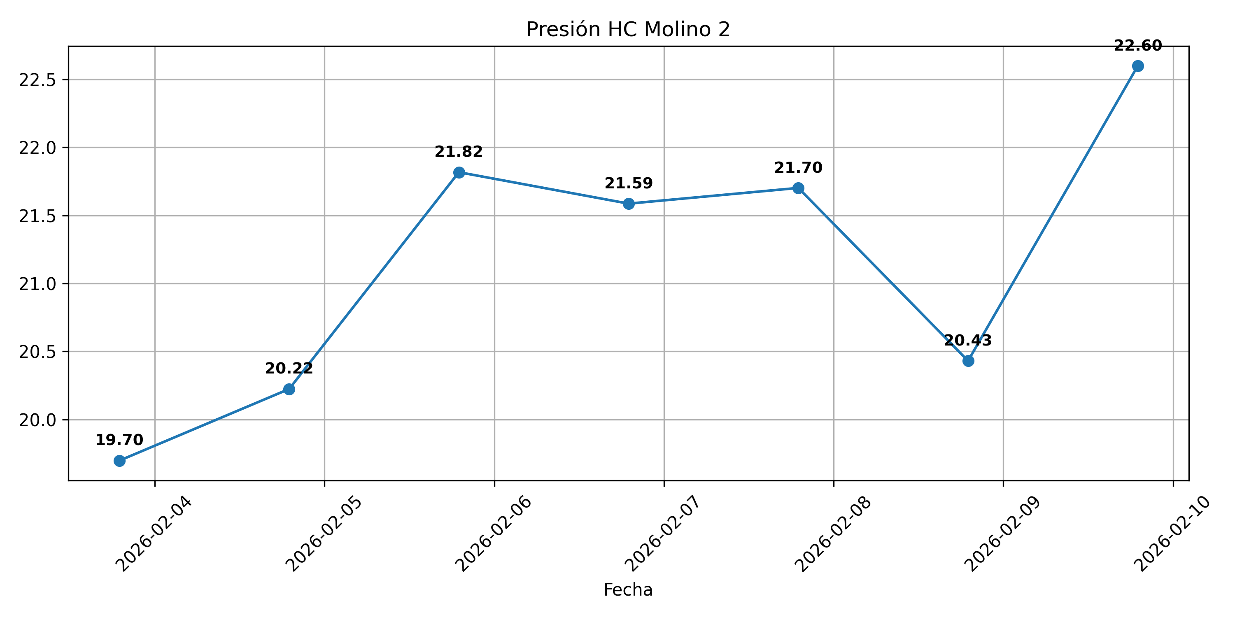
Sistema 4: Molino 2

Slide 9
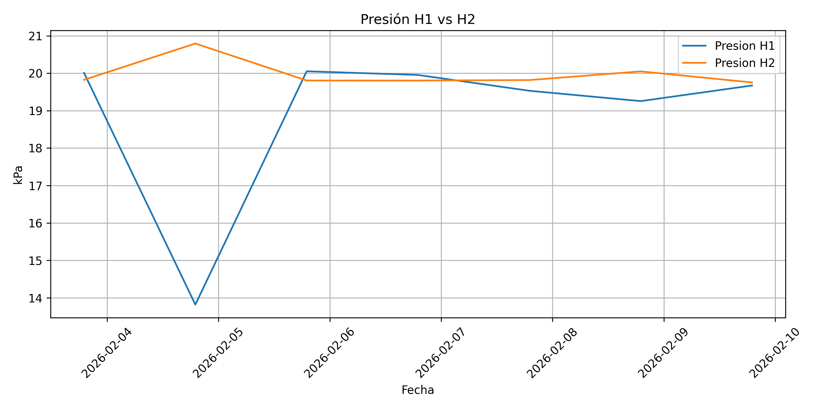
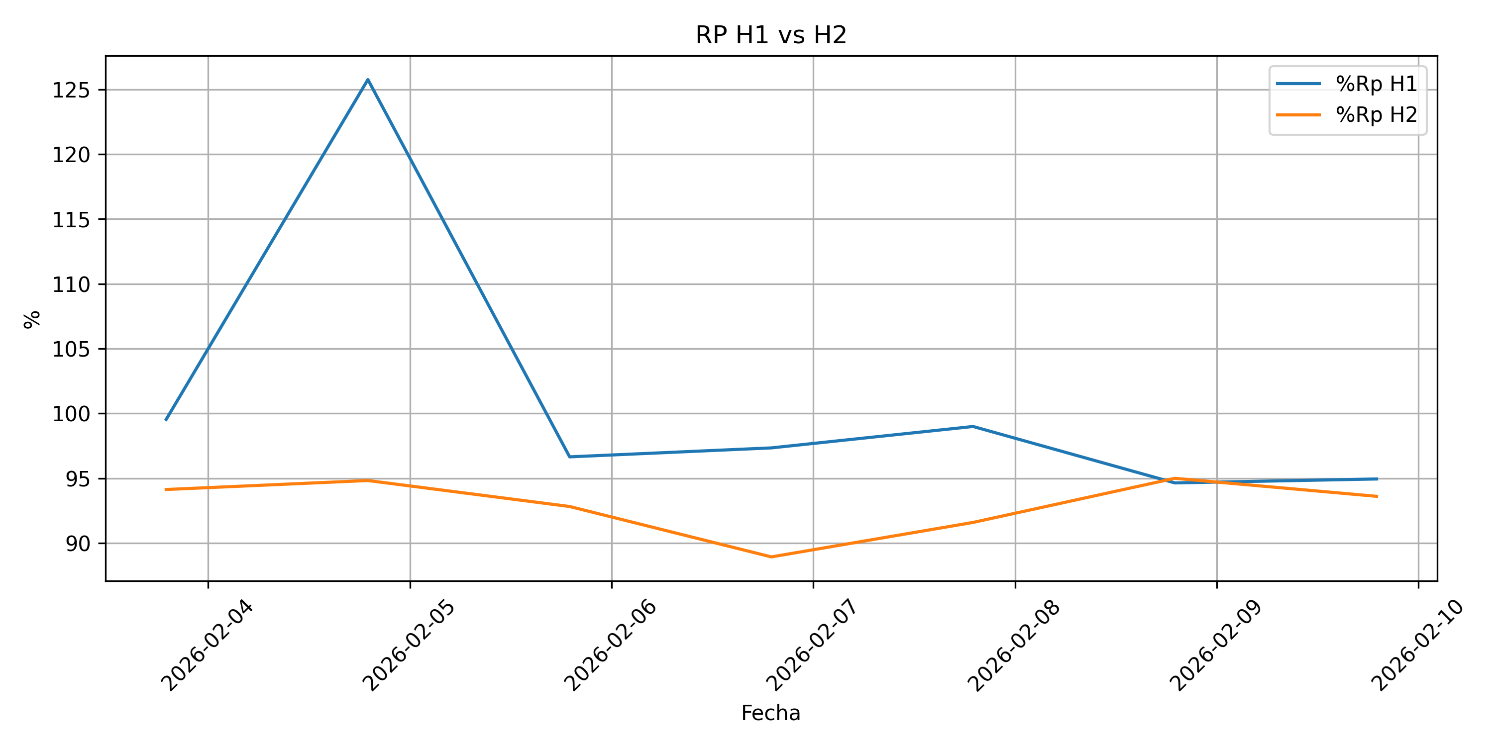
Sistema 5: Hidroseparadores

Slide 10
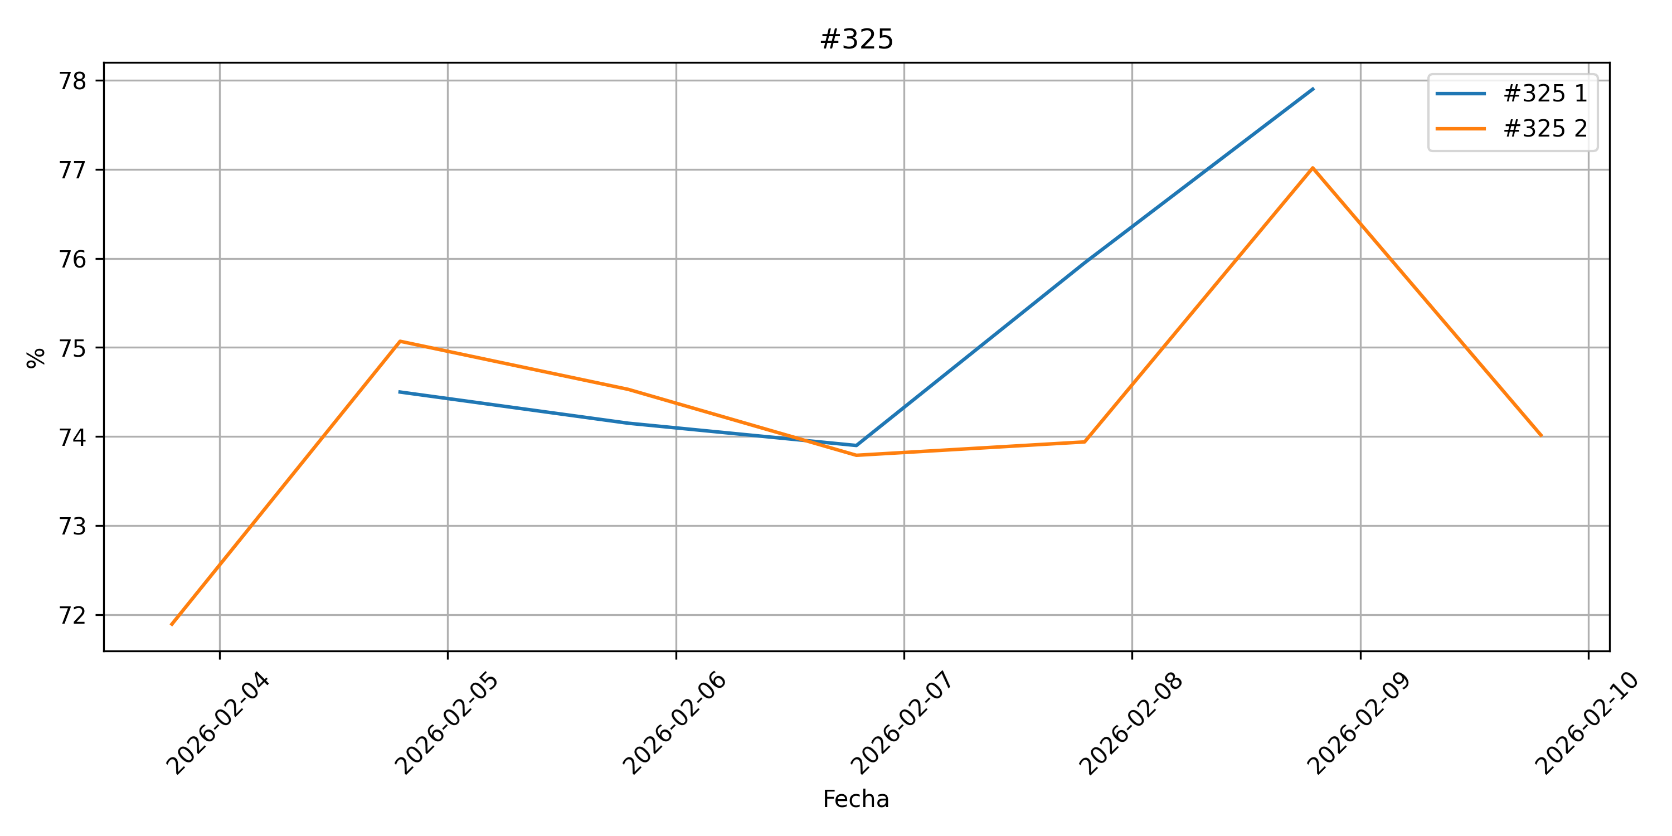
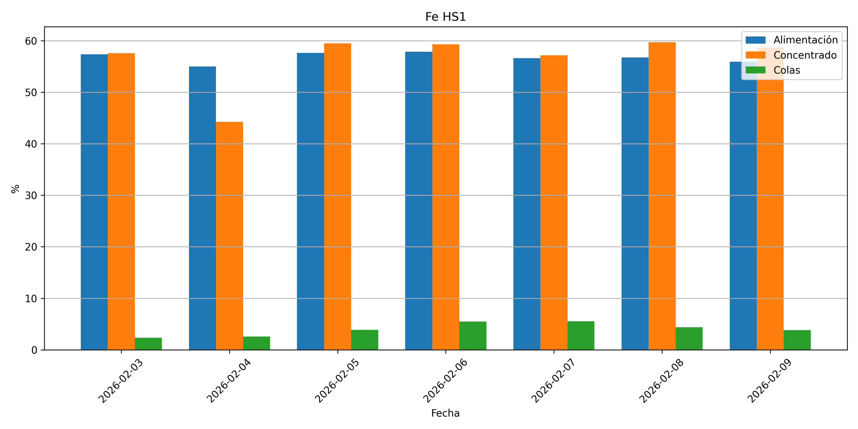
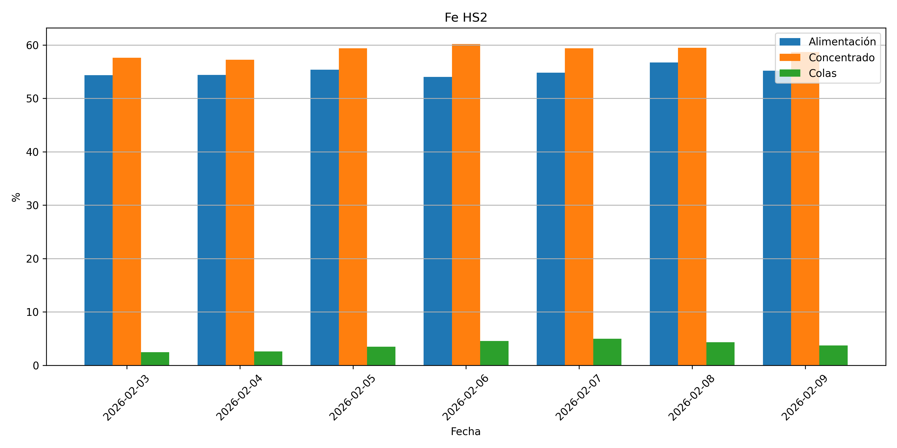
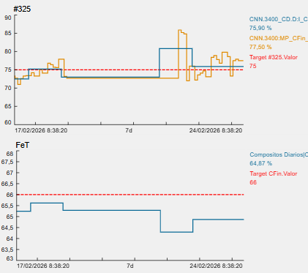
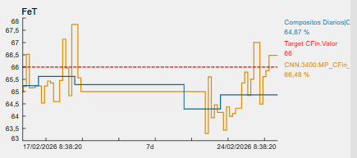
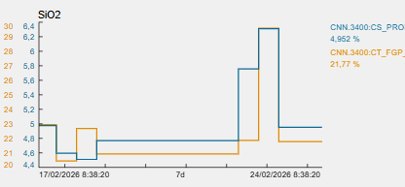
Sistema 6: Finisher

